Slide 1
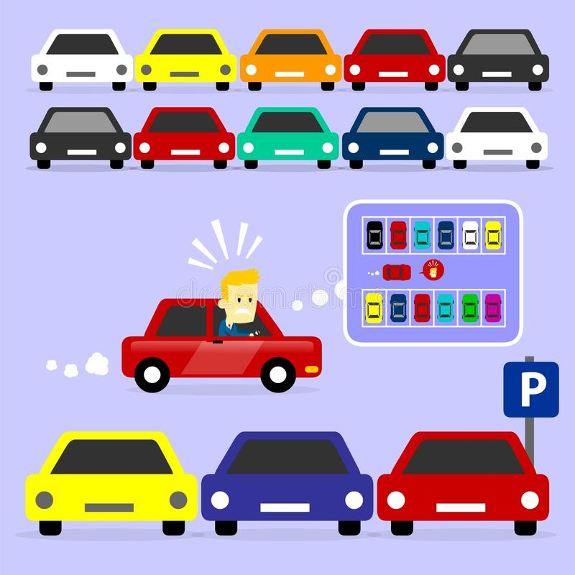
Campus Parking
Team -3

Slide 2
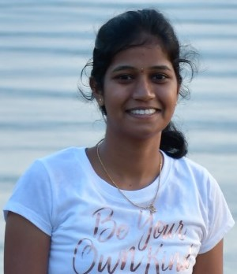
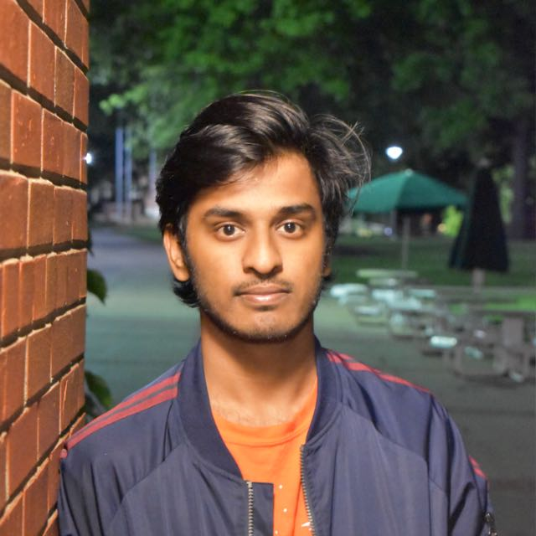
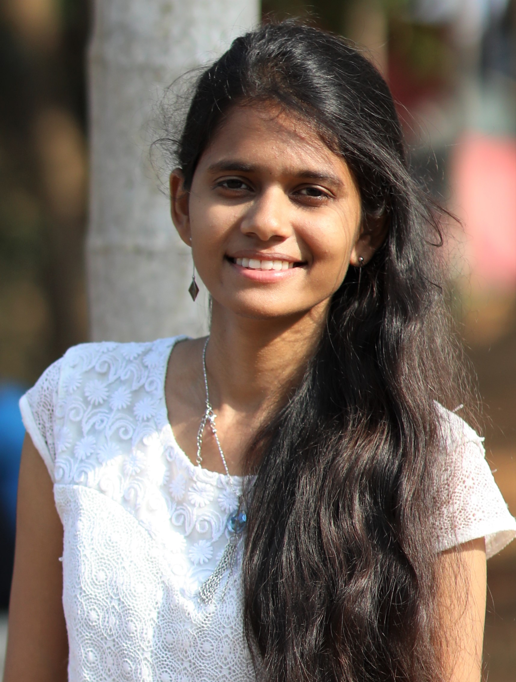
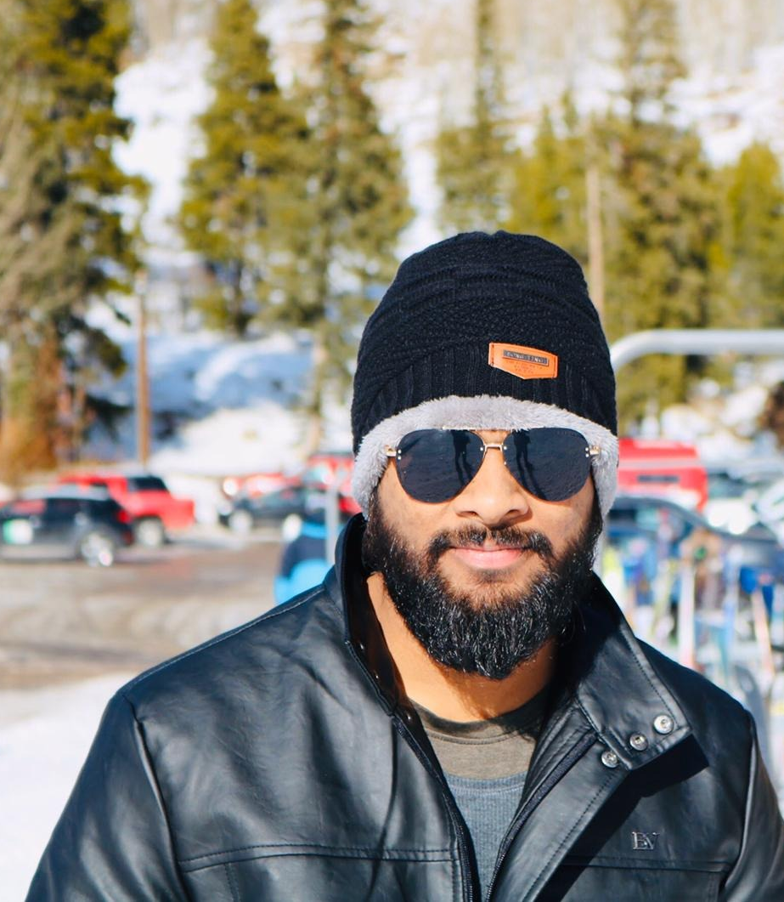
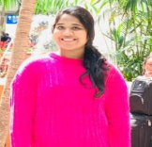
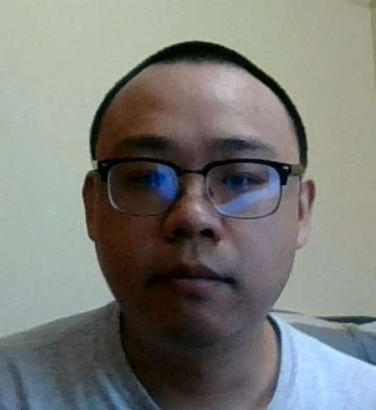
Team Members
Alekya Pochampally
Chetan Kudaravalli
Chinmayi Ambati
Manideep Chamala
Manisha Mengani
Xizi Chen

Slide 3
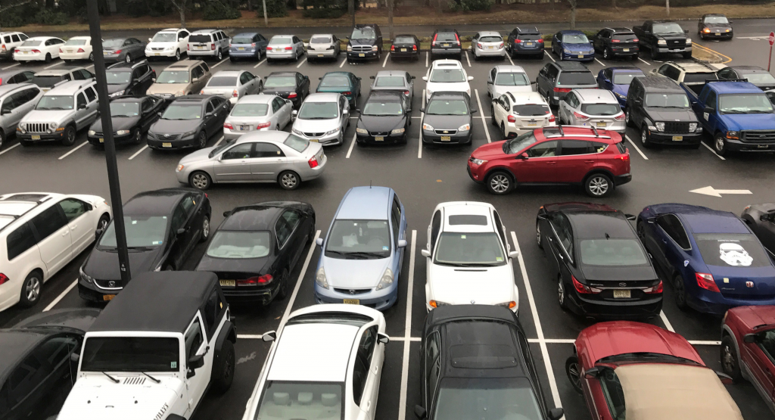
Problem and Goal
Our campus has over 10 parking areas but it’s still hard for students and staff to find a parking lot during the rush hours.
The goal of this application is to provide people with convenience and make parking more efficient.
The personal goal is to gain experience by going through a whole software development lifecycle, learn Dart and Flutter by developing this app for android/IOS.

Slide 4

Application Description
This application helps the user to find the available parking lots on the campus.
User Actions:
They will update the application soon after occupying/vacating the parking slot.
Can post their queries, interact in live chat and get solutions

Slide 5

Content
Problem and Goal
Application Description
Requirements
ER Diagram
Last term completed slides
Individual slides
Summary
Q & A

Slide 6

Requirements
Hardware Requirements
Processor: Minimum 1 GHz; Recommended 2 GHz or more
Wireless adapter (Wi-Fi) or Mobile Data (3G/LTE)
Hard Drive: Minimum 16GB; Recommended 64GB or more
Memory (RAM): Minimum 1GB; Recommended 4GB or above

Slide 7

Requirements
Software Requirements
Flutter
Firebase
Dart
Visual Studio
Android studio and Emulator
Communications Interfaces
iOS
Android

Slide 8
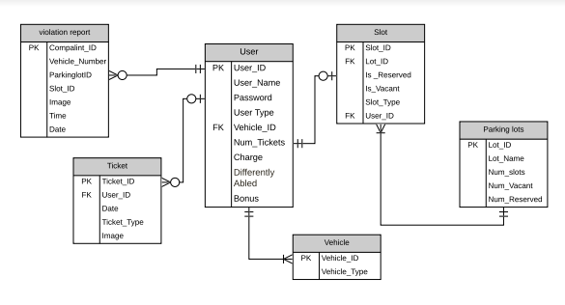
ER Diagram

Slide 9
Last term completed tasks

Slide 10

Tasks
Objectives
Login Screen - Alekya, Manideep
Sign up Screen - Chinmayi, Manisha
Forgot password Screen - Chetan, Chen

Slide 11

Individual Tasks

Slide 12
Alekya Pochampally
Objectives responsible for
Ticket Screen - 100%
Home Screen (occupy, vacate) - Backend
Hamburger menu - Icons styling
Report and Violation Screens - UI styling
Live chat Screen- Chat window designing
Contact us Screen - Cards designing
Login Screen - 100%

Slide 13
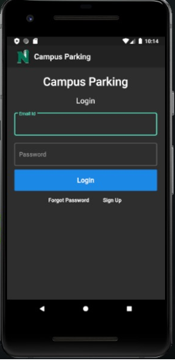
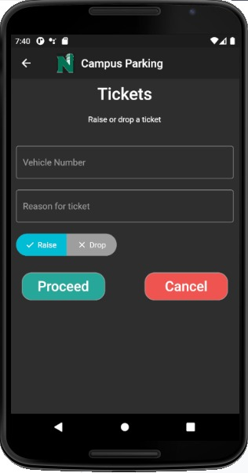
UI Screens

Slide 14
Chetan Kudaravalli
Objectives responsible for
Home Screen (occupy, vacate) - 100%
Parking Screen – 100%
Hamburger menu - Image styling
Profile Screen - Backend
Map Screen - Adding latitudes and longitudes
Report Screen - Adding ‘crop’ functionality
Forgot password Screen - 100%

Slide 15
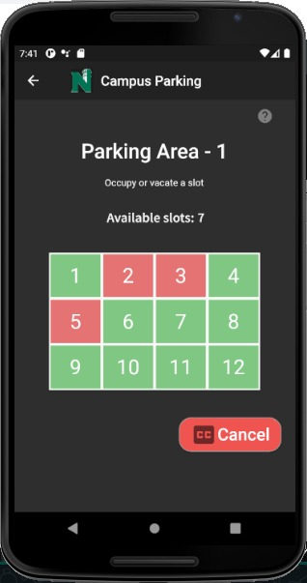
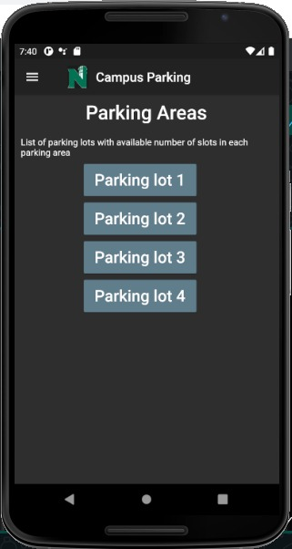
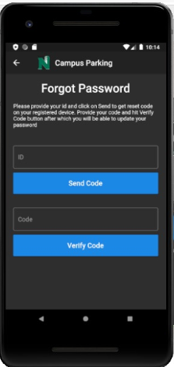
UI Screens

Slide 16
Chinmayi Ambati
Objectives responsible for
Report Screen - 100%
Report Violation Screen - 100%
Map Screen - Adding camera positions
FAQ Screen - Adding padding to the texts
Login Screen - Styling and redirecting to sign up page
Sign up Screen - 100%

Slide 17
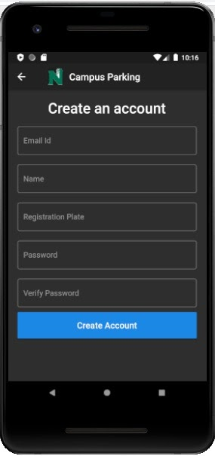
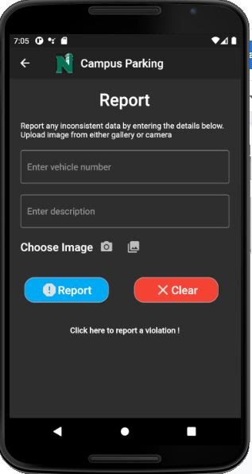
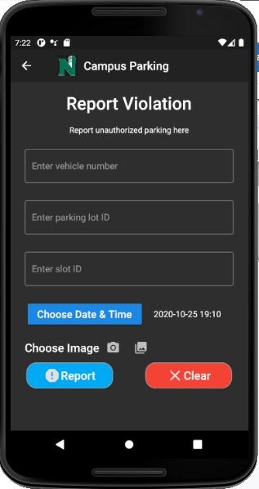
UI Screens

Slide 18
Manideep Chamala
Objectives responsible for
Hamburger menu and internal routings - 100%
Profile Screen - 100%
Report Violation Screen - Styling all the icons in UI
Contact us Screen - 100%
Ticket Screen - UI styling

Slide 19
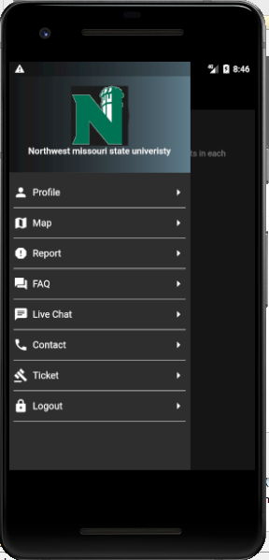
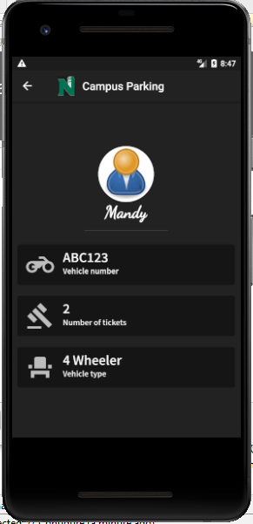
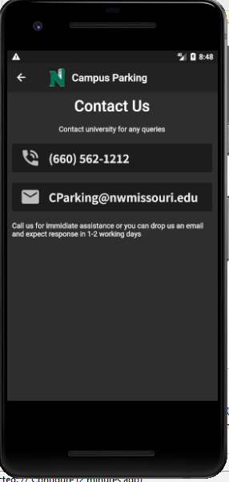
UI Screens

Slide 20
Manisha Mengani
Objectives responsible for
Hamburger menu and internal routings - Redirect to map and ticket page
Map Screen - 100%
Live chat Screen - 100%
Sign up Screen - Styling the buttons
Forgot password Screen - Styling the UI

Slide 21
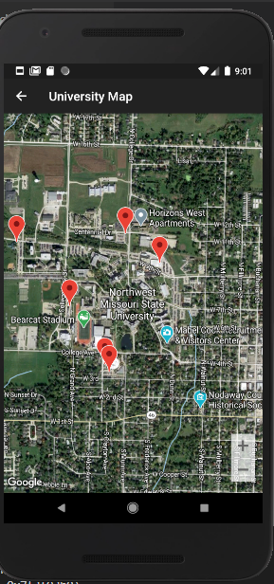
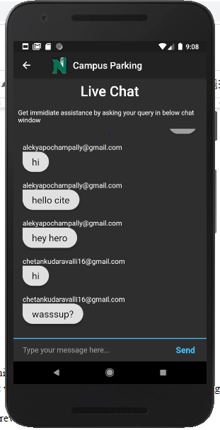
UI Screens

Slide 22
Chen Xizi
Objectives responsible for
FAQ page - 100%
Home page - 30%
Live Chat -30%

Slide 23
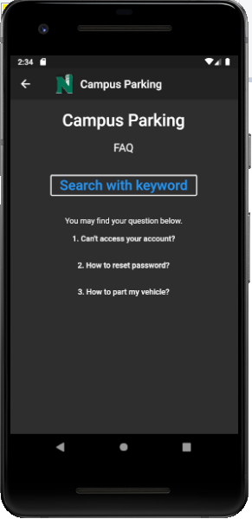
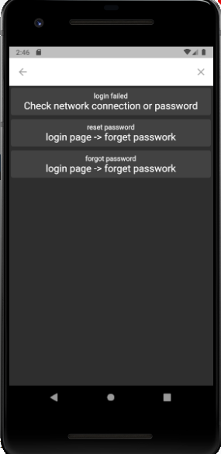
UI Screens

Slide 24
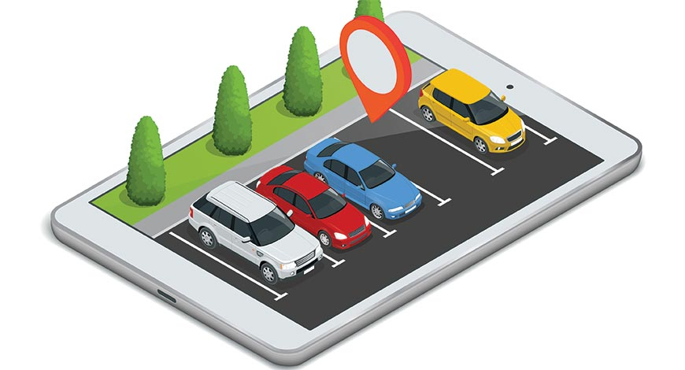
Summary
This application will help the user in the following ways
Find the available parking slots
Interact and find the solution for their issues
View the campus map for easy understanding of routes
Report any violations or inconsistent data to make the application more efficient
With all these features, we hope to make parking effortless and that the users will find the application beneficial.

Slide 25
Any Questions?
Alekya Pochampally
Chetan Kudaravalli
Chinmayi Ambati
Manideep Chamala
Manisha Mengani
Xizi Chen

Slide 26


